Slide 1
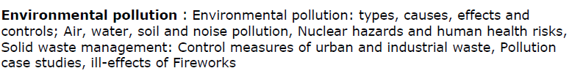
Pollution and Solid Waste

Slide 2
Pollution is the introduction of contaminants into the natural environment that cause adverse change. Pollution can take the form of chemical substances or energy, such as noise, heat or light.
Pollutants, the components of pollution, can be either foreign substances/energies or naturally occurring contaminants.

Slide 3
Types of Pollution
Air Pollution
Water Pollution
Soil Pollution
Noise Pollution
Radiation Pollution

Slide 4
Noise Pollution

Slide 5
Noise Pollution
Refers to loud sound created by humans or machines that disrupt the environment and normal living of organism in it.
The unwanted noise dumped into the atmosphere that leads to discomfort
and health hazards is known as noise pollution.
Sources of Noise Pollution
Natural phenomena such as violent volcanic eruptions, thunder, fierce storms, etc.
Domestic appliances such as mixers, washing machines, telephones, etc.
Industries such mills and factories
Automobiles –music system n constant honking by drivers.
Noise by Trains, ships, and aircrafts
Bursting of crackers and playing loud music during social
gatherings and festivals.
Entertainment devices such as radio, television, etc.

Slide 6
Auditory effects:
Temporary deafness or hearing loss etc.
Non-auditory effects:
Effects on human health
Physiological disorder
Loss of working efficiency
Insomnia
Effects on wildlife

Slide 7
Control of Noise Pollution
Control at receiver’s end:
For the people working in noisy installations, ear-protection aids like earplugs, noise
helmets, headphones etc must be provided
Suppression of noise at source:
It is possible by improving the method of working by
Designing, fabricating and using quieter machines to replace the noisy ones
b) Proper lubrication and better maintenance of machines
c) Installing noisy machine in soundproof chamber
d) Using silencer to control noise from automobiles, ducts exhausts etc.
Covering noise-producing machine parts with sound– absorbing materials to check noise production.
Reducing the noise production from a vibrating machine by vibration damping (rubber, neoprene etc.)

Slide 8
Acoustic Zoning
Increased distance between the source and receiver
by zoning of noisy industrial areas, bus terminals and
Railway stations away from the residential areas would
go a long way in minimizing noise pollution
Planting of Trees
Planting green trees and shrubs along roads, hospitals,
educational institutions to a help in noise reduction to a
considerable extent

Slide 9
Legislative measures
Strict legislative measures need to be enforced to curb
The menace of noise pollution. Some of them could be:
i) Minimum use of loudspeakers and amplifiers, specially
near silence zones.
ii) Banning pressure horns in automobiles
iii) Framing a separate Noise Pollution Act.

Slide 10
Air Pollution Causes, Effects And Solutions
https://www.youtube.com/watch?v=bTsxx1KZwlM
Water pollution
https://www.youtube.com/watch?v=IG3thzNUIdY
Soil Pollution
https://www.youtube.com/watch?v=00c4goQRLek
Noise Pollution
https://www.youtube.com/watch?v=-VaaTn_g1_k
Radioactive Pollution
https://www.youtube.com/watch?v=KxlgRHf_7oA

Slide 11
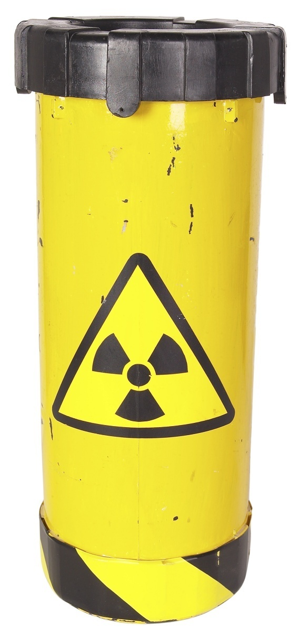
Radiation Pollution
Radiation pollution is the emission of any form of
ionizing or non-ionizing radiation as a result of
natural or human activities.
Causes of Radiation Pollution
Radioactive waste from nuclear power plants
Nuclear explosions
Medical use
Radiations from luminous watches, clock dials,
X-rays from microwave, etc.

Slide 12
Effects of Radiation Pollution
Somatic Effects
Radiations can cause skin cancer, bone cancer, reduction of life span, premature ageing etc.
Genetic Effects- Change in DNA
Increase in the number of abnormal children and increased infant mortality.
Control of Radiation Pollution
Dense trees should be planted around atomic power plants.
Proper management of radioactive waste should be ensured.
Unnecessary X-ray examination should be avoided. Lead shields should be used by workers.
During nuclear installations, various efforts including the process of site selection, its design, construction, operation, and its short-term and long-term effects should be seriously considered to control radiation.

Slide 13
Related links
Radioactive Pollution
https://www.youtube.com/watch?v=KxlgRHf_7oA
Nuclear hazards. Cause, effect and control
https://www.youtube.com/watch?v=Xvz3jh7ujZg
https://www.youtube.com/watch?v=aABtBR3t-Ek

Slide 14
9. A moth having a speckled wing, able to blend into its background due to its dark colouration is called
Industrial melanism
Adaptation
Predation
Evolution
10. Carbon dioxide is primarily called a greenhouse gas because
Traps heat
Traps light
Traps warm currents
None of the above
11. Trichoderma harzianum is a ________ that is predominantly used as a fungicide
Virus
Fungus
Bacteria
Protozoa
12. Greenhouse gases are those that absorb and emit infrared radiation. Examples inlude__________
Nitrogen
Ozone
Argon
None of the above

Slide 15
9. A moth having a speckled wing, able to blend into its background due to its dark colouration is called
Industrial melanism
Adaptation
Predation
Evolution
10. Carbon dioxide is primarily called a greenhouse gas because
Traps heat
Traps light
Traps warm currents
None of the above
11. Trichoderma harzianum is a ________ that is predominantly used as a fungicide
Virus
Fungus
Bacteria
Protozoa
12. Greenhouse gases are those that absorb and emit infrared radiation. Examples inlude__________
Nitrogen
Ozone
Argon
None of the above

Slide 16
13. Depletion of the ozone layer is damaging to human health. Negative effects include
Skin cancers
Osteoporosis
Dyspepsia
None of the above
14. __________ is an organism used to gauge the quality of an ecosystem.
Decomposers
Predator
Bio-remediator
Bioindicator
15. _________ is a waste disposal method where solid organic wastes are converted to the residue and gaseous products through combustion.
Incarnation
Incineration
Incarceration
Incubation

Slide 17
13. Depletion of the ozone layer is damaging to human health. Negative effects include
Skin cancers
Osteoporosis
Dyspepsia
None of the above
14. __________ is an organism used to gauge the quality of an ecosystem.
Decomposers
Predator
Bio-remediator
Bioindicator
15. _________ is a waste disposal method where solid organic wastes are converted to the residue and gaseous products through combustion.
Incarnation
Incineration
Incarceration
Incubation

Slide 18
Thank you

